Slide 1
Advanced Gameplay Mechanics
Survival
First-third/person
For multiplayer in unreal engine

Slide 2
Table of contents | Agenda
01
About the project
04
Sneak peek
What’s on the table
Research about metaverse
AV/VR in society
Gameplay Mechanics
02
05
Major requirements
Project stages
research on different time marks milestones – tech use
Product comparisons
Product reverse engineering
Unveil of budling stages
Research
Develop
Evolution / Iteration Build
03
06
Matrix
Project goals
Enter the
Said enough!
User-centric mind enabled
Interactive Genre Gameplay Mechanics
Notes:
In section 1 history and general view with more images, 2 more text with less images, 3 specify genre of gameplay mechanics, 4 video presentation, 5 workflow SDLC lifecycle + image of word here, 6 ??? (insert transitions to specific slides e.g., 6) .. Say that project is based and inspired by Advanced Light Actor – Roland Simigla and Horror Engine – tansuergene in Epic Games Unreal Engine Marketplce

Slide 3
Gameplay Mechanics
01
About the project
Research about metaverse
AV/VR in society
Gameplay Mechanics

Slide 4
What are we working on?
Metaverse
AR/VR
Gameplay Mechanics
The future of Internet evolution known as second life is expanding in multiple life software simulations in physical or virtual world
Hardware Interfaces to interact with the immersive daily life simulated worlds
The software APIs of AR/VR to bridge hardware with software user interaction inside metaverse plus way more

Slide 5
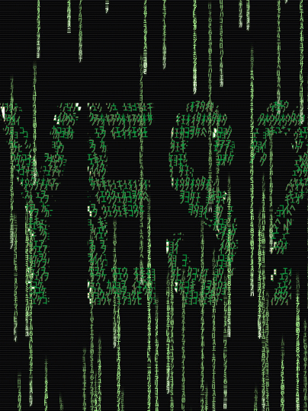
About the project
Bridging the gap between hardware and software communication for in-game interaction
Past, Present, Future exploration
Big-tech companies and vision of unified development (common software standards)
Metaverse was already here
Gameplay Mechanics can be characterized as the way to enter the
Matrix

Slide 6
“Consciousness isn’t a journey upward, but a journey inward. Not a pyramid, but a maze.”
—Bernard Lowe, Westworld season one episode 10

Slide 7
Gaming industry rise
Milestone Pandemic

Slide 8
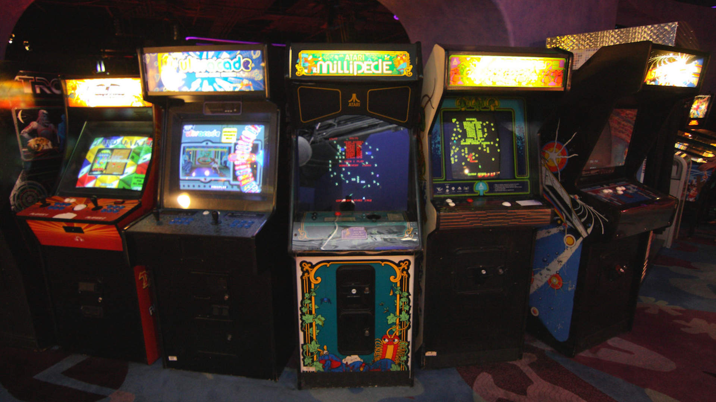
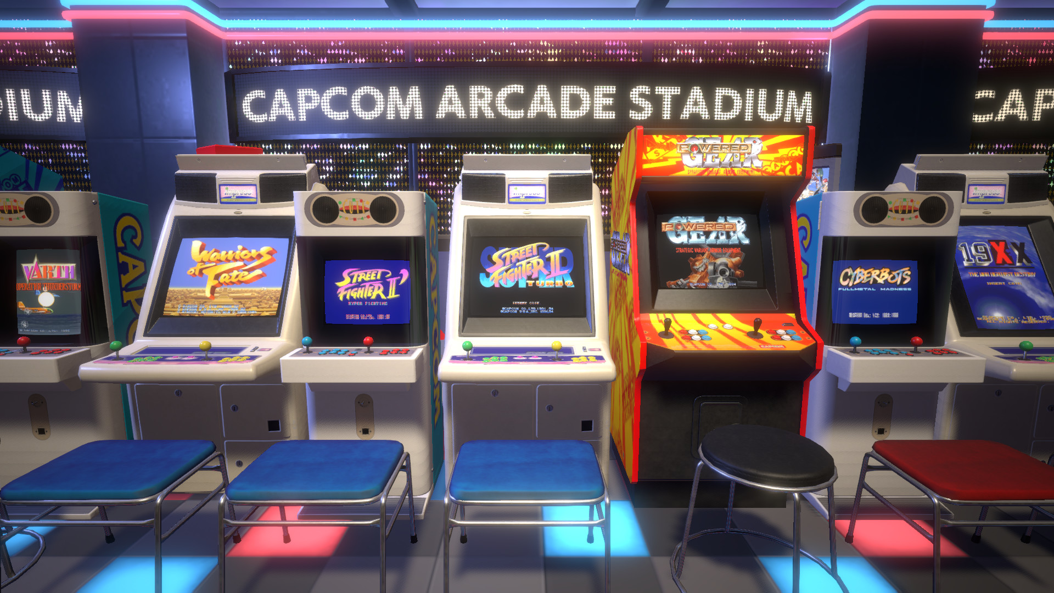
Metaverse concept implicitly began late 70’s.
a place to gather people & interactivity
To share common interests

Slide 9
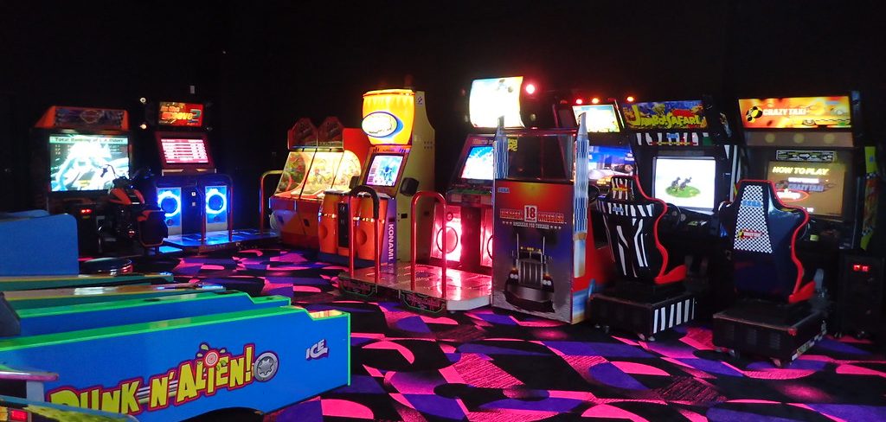
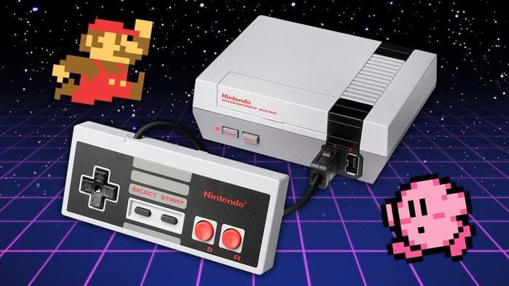

Flow of gaming/Simulation evolution (1)
This Photo by Unknown Author is licensed under CC BY-SA
This Photo by Unknown Author is licensed under CC BY-SA-NC
Arcade
Console
mobile
Entertainment
Entertainment
2D/3D gaming on a 2D screen to AR + Online social life by reading data
1978
1983
2007+

Slide 10

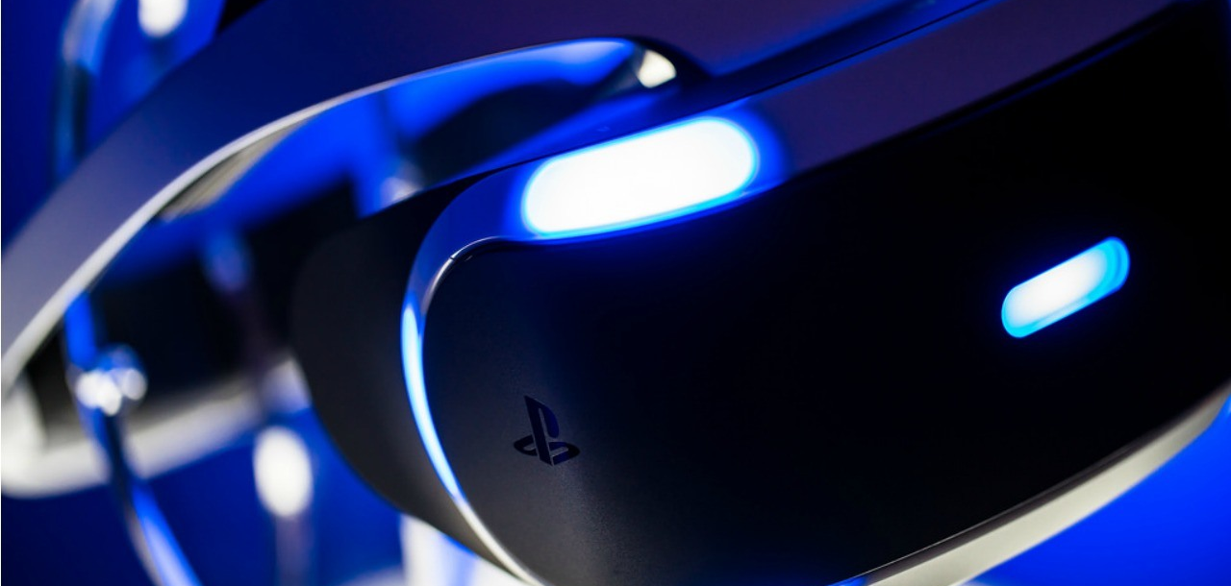
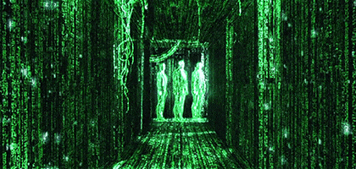
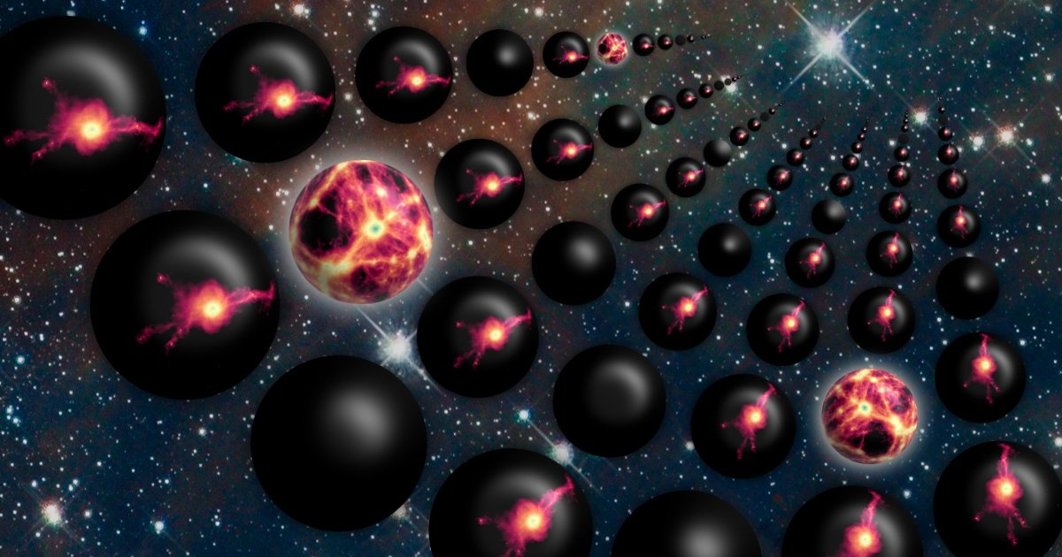
Flow of gaming/Simulation evolution (2)
This Photo by Unknown Author is licensed under CC BY-SA
Metaverse/s
This Photo by Unknown Author is licensed under CC BY
Virtual reality
Multi-verse
Second Life of everything, Inside Data, Dematerialization of physical space, distances and objects not only a virtual 2D/3D world.
Entertainment + Simulations of Healthcare & Sciences (STEM)
X Life Simulations, Dimensions, Origin
2019
2024+
????

Slide 11
Flow of gaming/Simulation evolution (3)
Web 1.0 - static
Browser
Websites
Web 2.0 - centralized
Mobile
Apps
Servers
Web 3.0 - decentralized
XR
A.I
Blockchain
Cloud
XR = x reality (e.g., AR,VR)

Slide 12
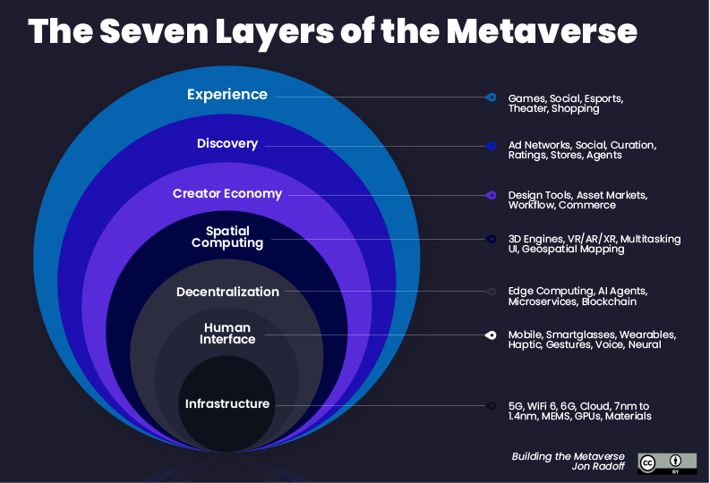
Flow of gaming/Simulation evolution (4)

Slide 13
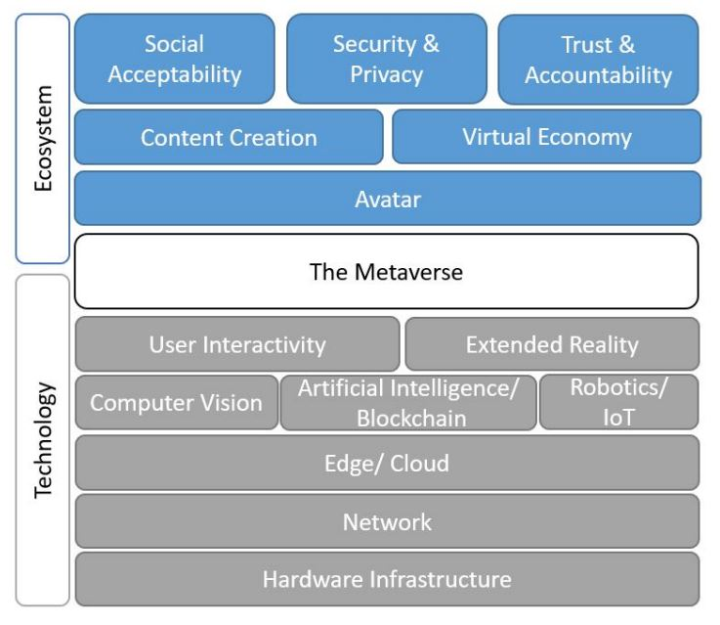
Flow of gaming/Simulation evolution (5)
Steps to Enable
Metaverses

Slide 14
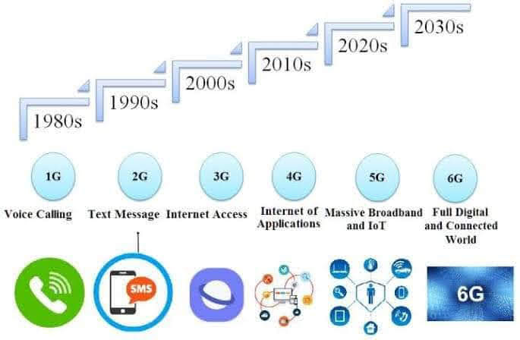
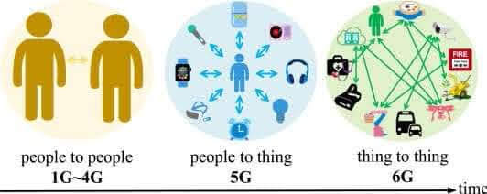
Flow of gaming/Simulation evolution (6)
– first Mile Connections Points
Low Latency/Jitter
High Bandwidth
Immersion /
No motion Sickness
Large Data Flow

Slide 15
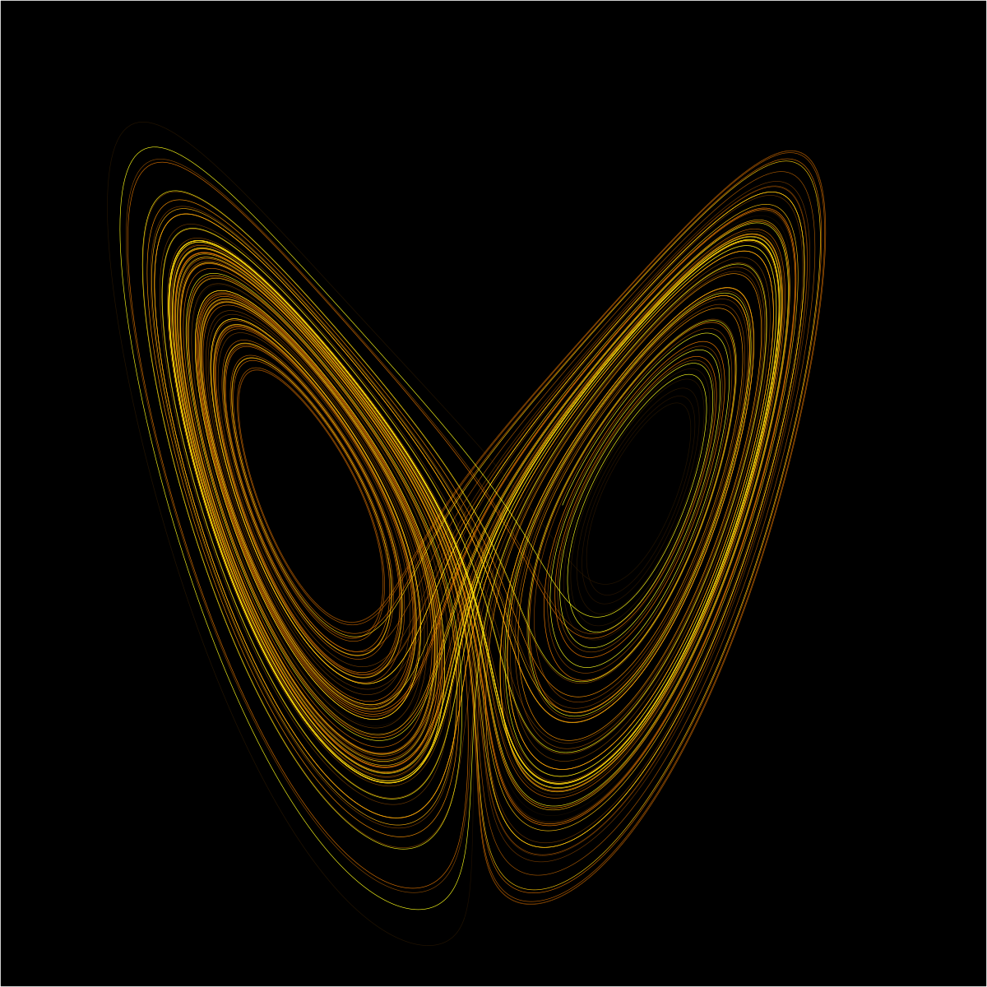
Butterfly effect
This action will
Have consequences
A place in space and time where Everything is interconnected
Notes:
Karma

Slide 16
Progress of evolution
Second Life
Second Reality
Reality
Lifestyle
Possibility
Second Life
Second Life
Science
Second Reality
Evolution
Reality Change

Slide 17
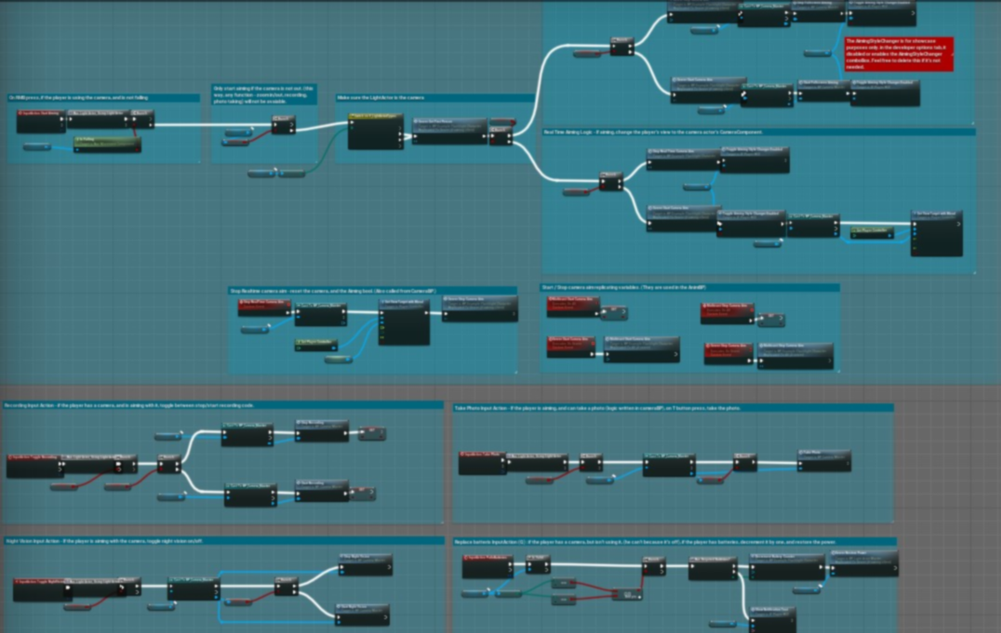
Programming behind everything
Gameplay Mechanics
"I trust code more than people anyway."
—Elsie Hughes, Westworld, S02 episode four
The world as numbers

Slide 18
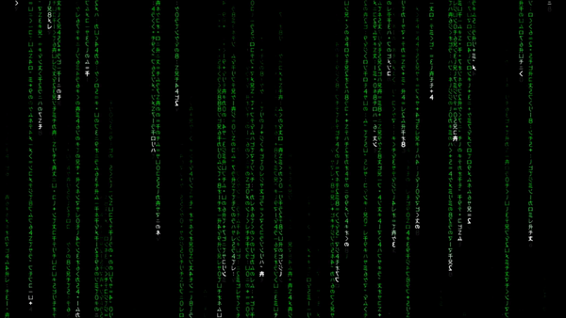
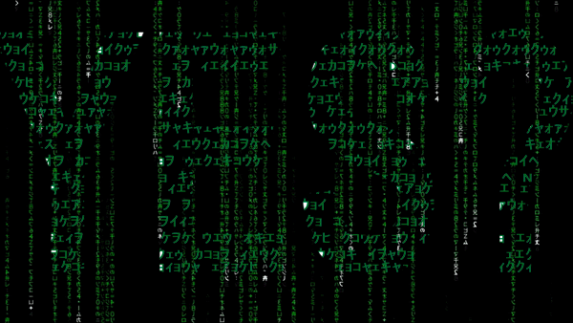

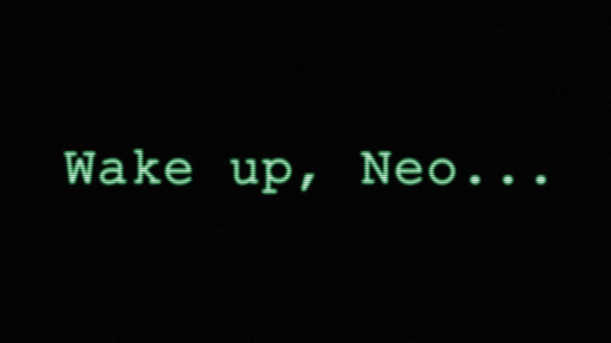
02
Major requirements
Research on time mark milestones
Game Comparisons
Product Reverse Engineer
Notes:
Say about UE etc. like doc slides

Slide 19
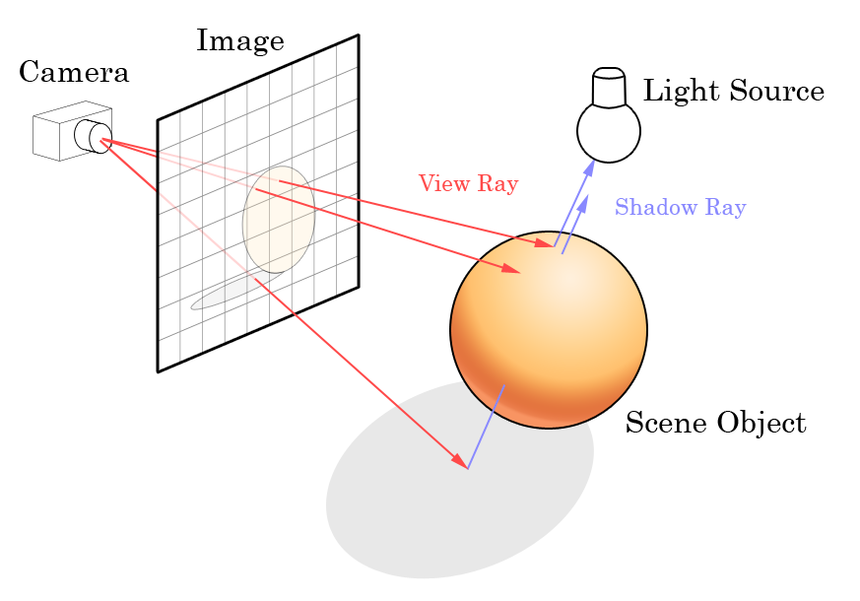
Past
Biggest limitation in complex polygon rendering is hardware infrastructure as main and as well as algorithmic approaches in efficiency
In addition to keeping a steady clock tick per frame for graphics/shaders rendering for Dynamic Global illumination & Reflections and FPS locked tick for logic execution usually (per 60 FPS 1 exec cycle)
Notes:
Ray Tracing

Slide 20

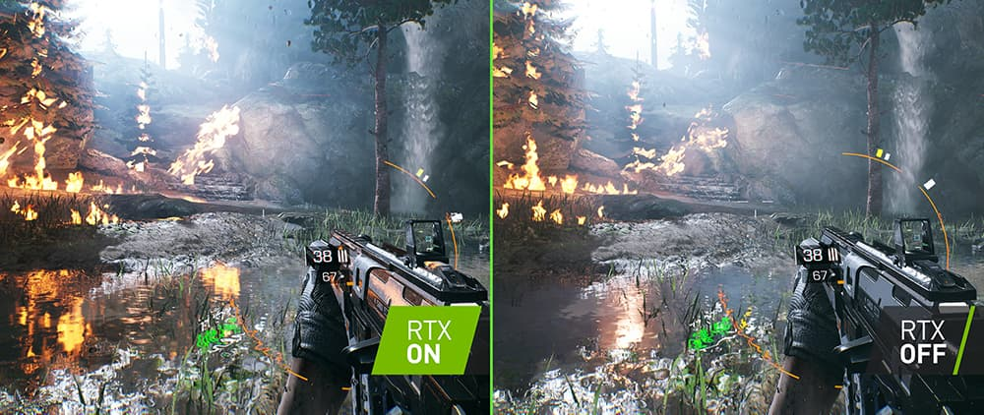
Now
Stronger Hardware resulted to make Ray- tracing an achievable goal
Algorithms have improved making possible Virtualized Geometry and eliminating the fact of complex polygon rendering (UE5)
Notes:
Ray Tracing

Slide 21
Future is
Instead of multiple Game Engines fighting in market place why not having 1 main engine and contribute globally to it for making tomorrows dream possible?
This actually already happening
Notes:
Ray Tracing

Slide 22
WHAT HAS BEEN ACHIEVED
And its in good way for perfection
Complex Scene Real-time Graphics/Shaders Rendering for Global illumination and Reflections
Believable Physics System out of the box
Easier Workflow and collaboration for same asset edit
Animation Support & Character Modeling
Visual Effects (VFX Niagara System)
Large Ecosystem of Support, Ideas, Assets & collaboration
Notes:
Ray Tracing (=lorem=(1))

Slide 23
WHAT HAS NOT BEEN ACHIEVED
Revolutionized AI System
100% Agnostic/Blur line for VR/AR/Film/Game workflow
Notes:
Ray Tracing

Slide 24
Metaverse concept (1)
Fortnite
SUBNautica
Open-World
Free-to-play
Battle Royale PVP
Multiplayer Cooperative TPP
Achievements/rewards
Learn
Entertainment
Open-World
Solo
Survival Action-Adventure FPP
Achievements/rewards
Learn
Entertainment
Notes:
Game Genre Category, FPP = First Person Perspective

Slide 25
Metaverse concept (2)
Its not about the numbers
Notes:
Game Population Charts

Slide 26
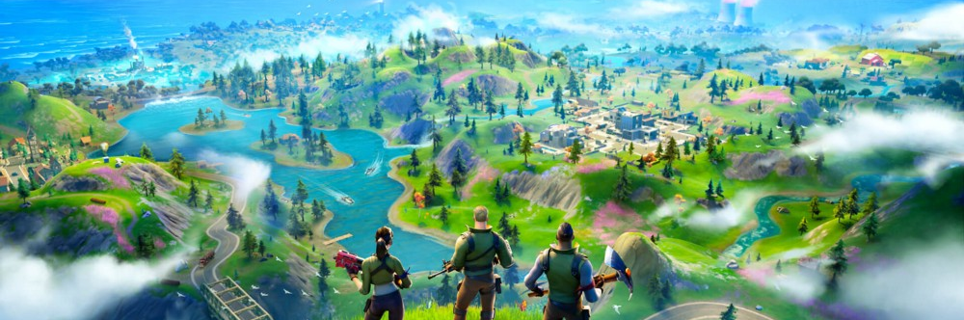
The metaverse is already here — it’s called Fortnite
A multiplatform centralized place for hanging out with friends/family, explore, entertainment, learn and the most important it’s consistent with vast evolution and development for years to come. Isn’t just a game it’s a place. A virtual universe.
Notes:
Fortnite articles from epic statement

Slide 27
Survival Horror (1)
Phasmophobia
forewarned
Co-op horror Survival FPP
Explore/Investigate
Puzzle
Entertainment
Co-op horror Survival FPP
Explore/Investigate
Puzzle
Entertainment
Notes:
Game Genre Category, TPP = Third person perspective

Slide 28
Metaverse concept (2)
Its not about the numbers
Notes:
Game Population Charts

Slide 29
Survival Horror (3)
Mechanics Overview
Phasmophobia
forewarned
VR
Enemy NPC
Inventory Items
NPC - Player HUD interaction
Diary-Quest book
VR
Enemy NPC
Inventory Items
NPC - Player HUD interaction
Diary-Quest book
Notes:
Mechanics description

Slide 30
Product reverse engineer
Forward
System Specification
Design and Implementation
New System
New System
Design and Implementation
System Specification

Slide 31
03
Project goals
User-centric mind enabled
Interactive Genre Gameplay Mechanics

Slide 32
User Experience
As with any product design must be user centric driven
Follow best practices and common standards from similar successful industry standard products. This will make the user conformable on the experience
Balance of inner systems that create a harmonic experience instead of fluctuations
Depends of the artistic style use this as your base direction. Give the touch of the feel you want to make pronounce
Think always that is more than a program it’s a product and just as good software is never done, good product design principles are never done
This brings us to welcome any change / new idea

Slide 33
Our Gameplay System
Survival horror genre experience T/FPP
Actor in-place Animations / Locomotion’s
Character Mannequin / Body appearance
Survival Gear for a ghost hunt
Diary – Quest/events System
Inventory
Save System
Inspection System
Footstep Sound System
NPC hunt mode
Network Replicated / Multiplayer Ready
Any many much more ..
Epic Games Unreal Engine Marketplace
Inspired and based on:
Advanced Light Actors – Roland Simigla
Horror Engine – tansuergene
Notes:
TPP/FPP == third first person perspective

Slide 34


Gameplay mechanics - DEMO
4
Sneak Peek
0
Progress
Notes:
Insert a horror after the main feature showcase with assets freaks of horror place and jumpscare with flare after run out of flashlight

Slide 35
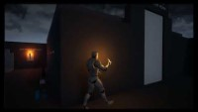
Gameplay mechanics - technical
4
Sneak Peek
0
Progress
Notes:
Insert a horror after the main feature showcase with assets freaks of horror place and jumpscare with flare after run out of flashlight

Slide 36
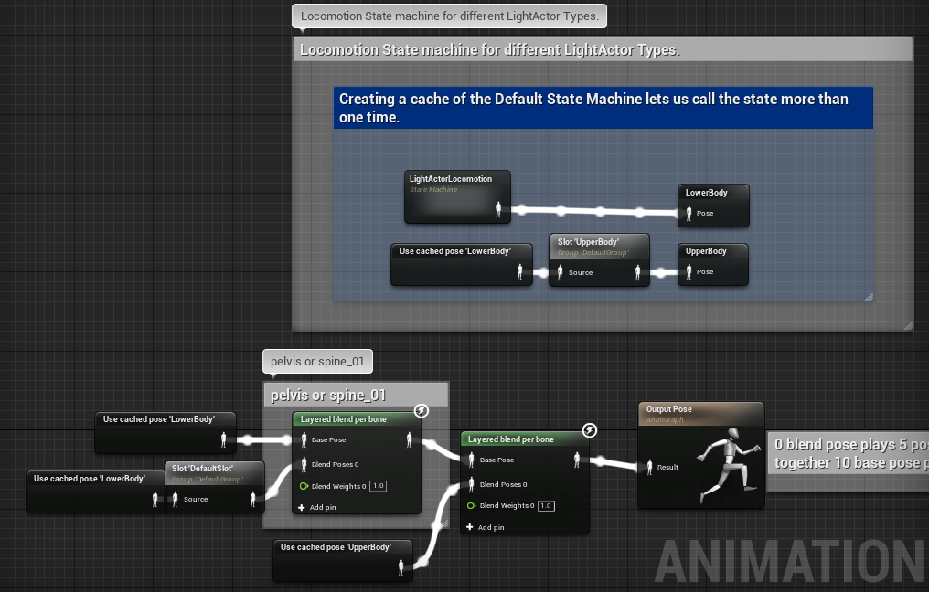
Gameplay mechanics - technical
4
Sneak Peek – State Machine/Locomotion
0
Progress
Notes:
Insert a horror after the main feature showcase with assets freaks of horror place and jumpscare with flare after run out of flashlight

Slide 37
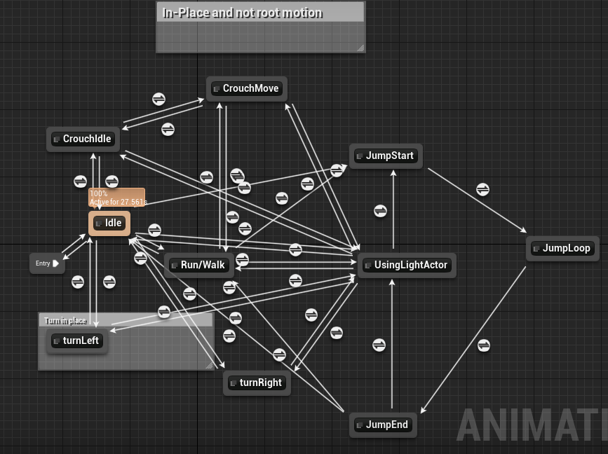
Gameplay mechanics - technical
4
Sneak Peek – State Machine/Locomotion
0
Progress
Notes:
Insert a horror after the main feature showcase with assets freaks of horror place and jumpscare with flare after run out of flashlight

Slide 38
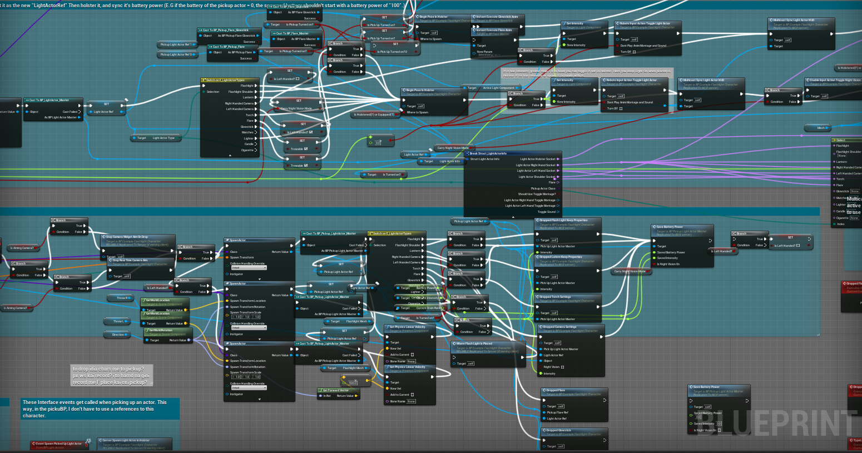
Gameplay mechanics - technical
4
Sneak Peek – Actors Logic (segment)
0
It looks pretty ugly but it will get better !
Progress
Notes:
Insert a horror after the main feature showcase with assets freaks of horror place and jumpscare with flare after run out of flashlight .. Write-time speed > run-time speed

Slide 39
05
Project Stages
Unveil of budling stages
Research
Develop
Evolution / Iteration Build

Slide 40
“In the Age of Digital, every business is a software business.
Agility isn’t an option, or a thing just for technical teams, it is a business imperative.”
—Dean Leffingwell, Creator of SAFe'
© Scaled Agile, Inc.

Slide 41
SDLC & DEV-OPS for R&D
Provision
Hardware infrastructure (Dedicated Servers + Database storage)
Software lifecycle
automation
iteration

Slide 42
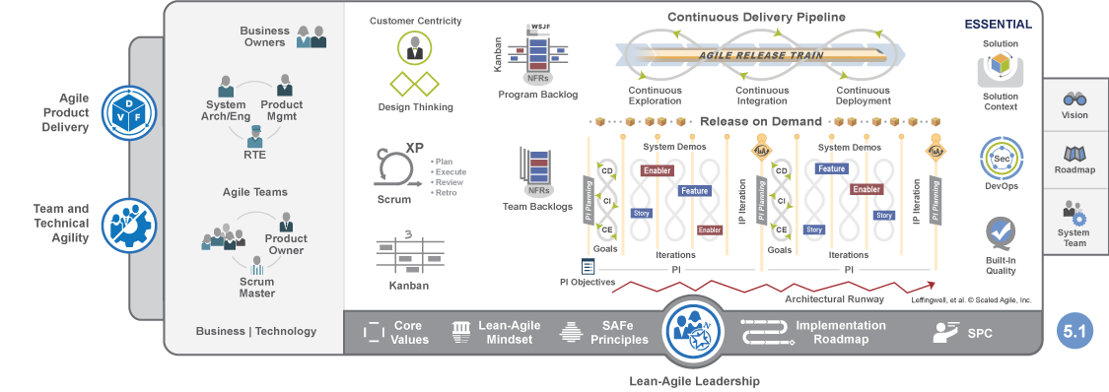
e
SAF Framework
Notes:
How entire business interacts with R&D team and it is not is siloed from business executives or any other department

Slide 43
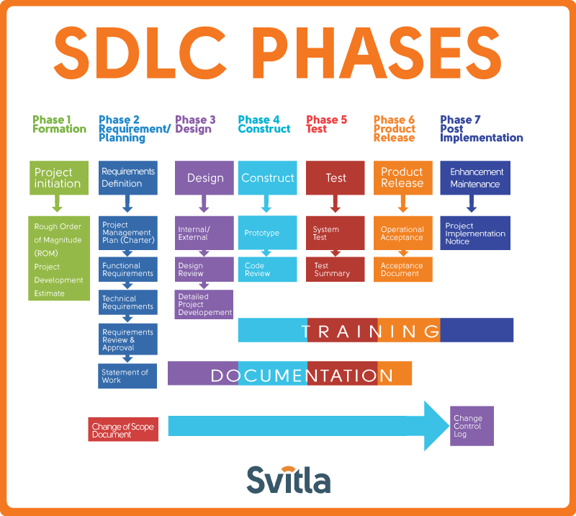

Slide 44
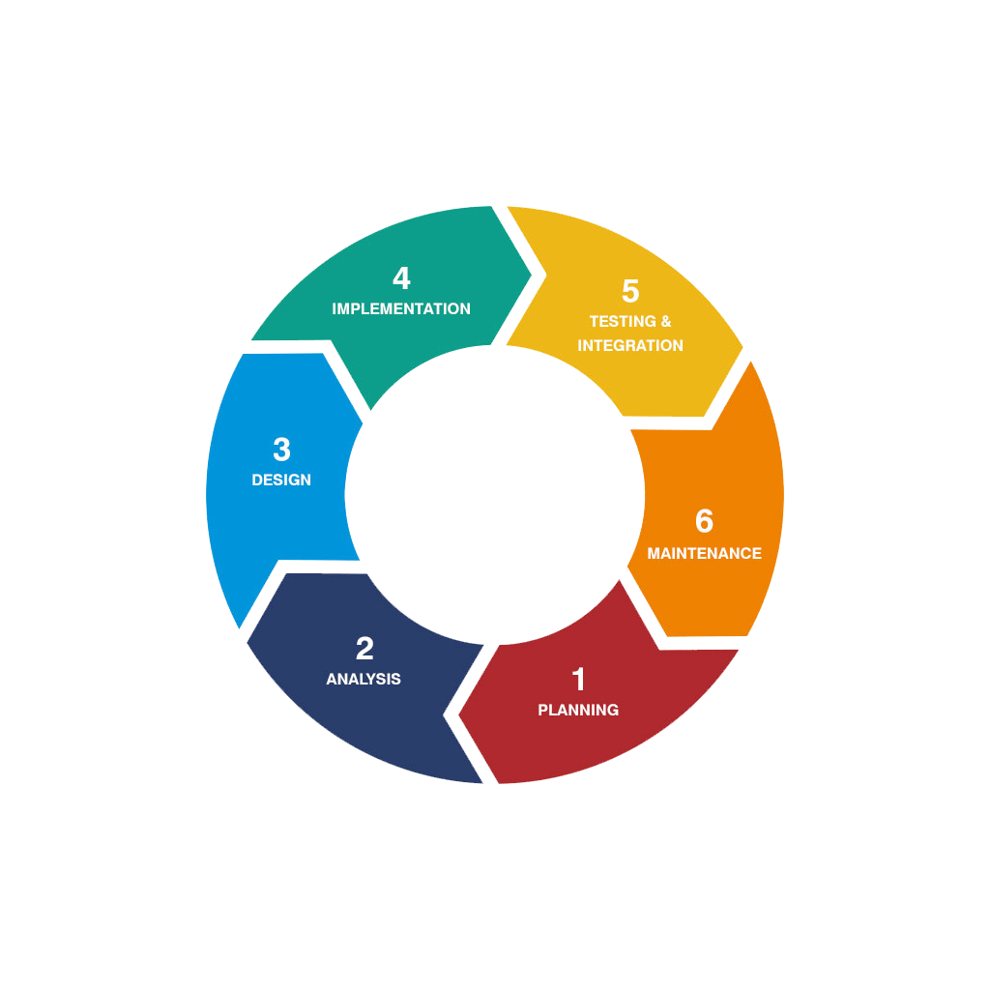
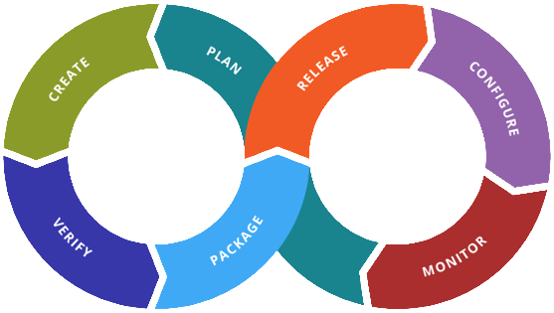
Agile & Devops Converge
Common Standards & Best Practices
Notes:
Agile computing in practice see slides SAFe Framework, SDLC & Dev ops

Slide 45

Enter The
6
0
Matrix
A glimpse of the future
NEAR

Slide 46
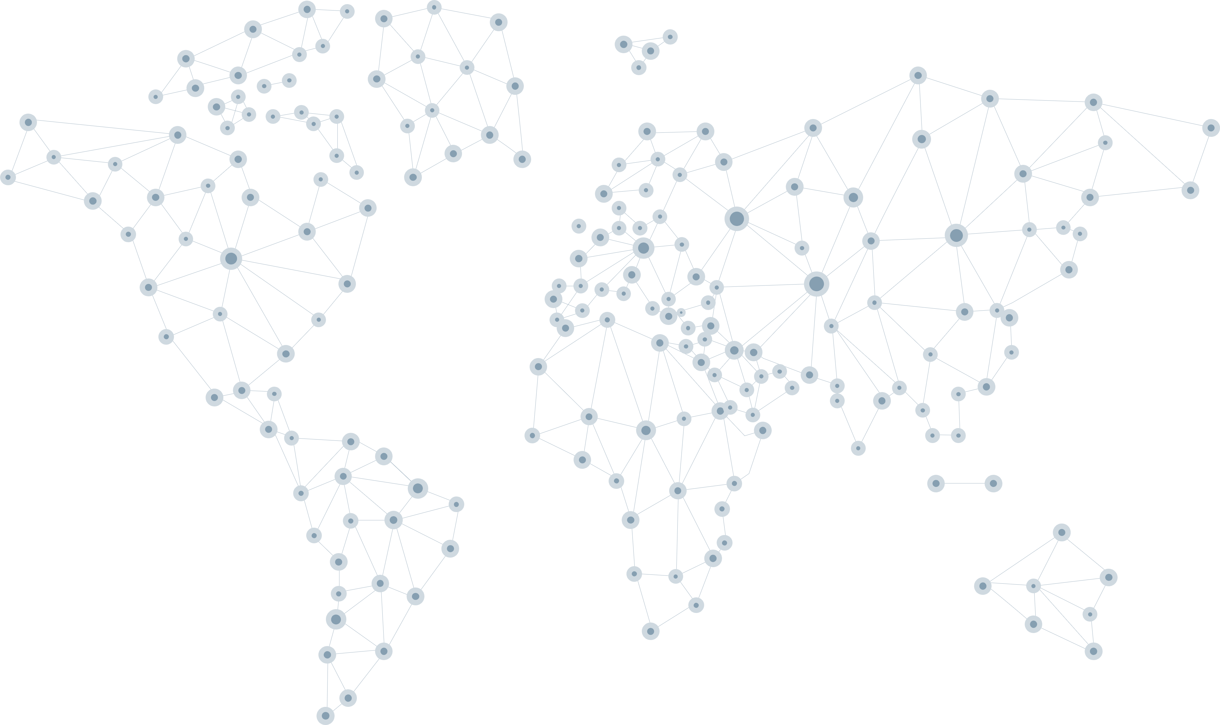
“these violent delights have violent ends.”
—Peter Abernathy, 'Westworld', from 'Romeo And Juliet'

Slide 47


The end is the beginning
and the beginning is the end
Dark –Netflix Series, Ouroboros
Notes:
Triquetra + Ouroboros

